Slide 1
CSE 3412 Feasibility Analysis
Sidratul Muntaha
Lecturer, DEPT. OF CSE, UIU
ACKKNOWLEDGED: SAMIN SHARAF SOMIK

Slide 2
You are required to present a feasibility analysis. For this, you’ll conduct a survey
among 5 x n persons (n = number of team members in your group)
In your presentation-
Briefly discuss how you gathered the information and what group (Age, Gender, Occupation) of people participated in the survey.
Discuss the questionnaire and the amount of responses in favor of each feature.
Discuss which features are feasible and which you are going to discard.
Discuss the Strengths, Weaknesses, Opportunities, and Threats.
Make each section comprehensive to get better marks.

Slide 3
One/ Two members (who haven’t presented before) from each group will give the presentation.
The other members will answer questions.
Duration of each presentation will be 5 minute.
The language of the presentation will be English.
Each group member needs to attend the class to get marks.

Slide 4
Briefly discuss how you gathered the information and what group (Age, Gender, Occupation) of people participated in the survey.
Mention the-
Medium of information gathering (via phone, email, social media etc)
Total Number of attendee
Group distribution statistics (e.g. 30% businessman, 55% female etc.)
https://www.visme.co/chart-maker/
https://www.canva.com/graph/

Slide 5
How many questions?
Create a questionnaire with at least 10 questions. When designing the question set, try to gather the following information-
If they already use any existing system that is similar to your project. (5 questions)
If they are interested in the features of your project. (5 questions)
Provide multiple choices for each question. You can keep open-ended
questions but make sure to keep that optional.

Slide 6

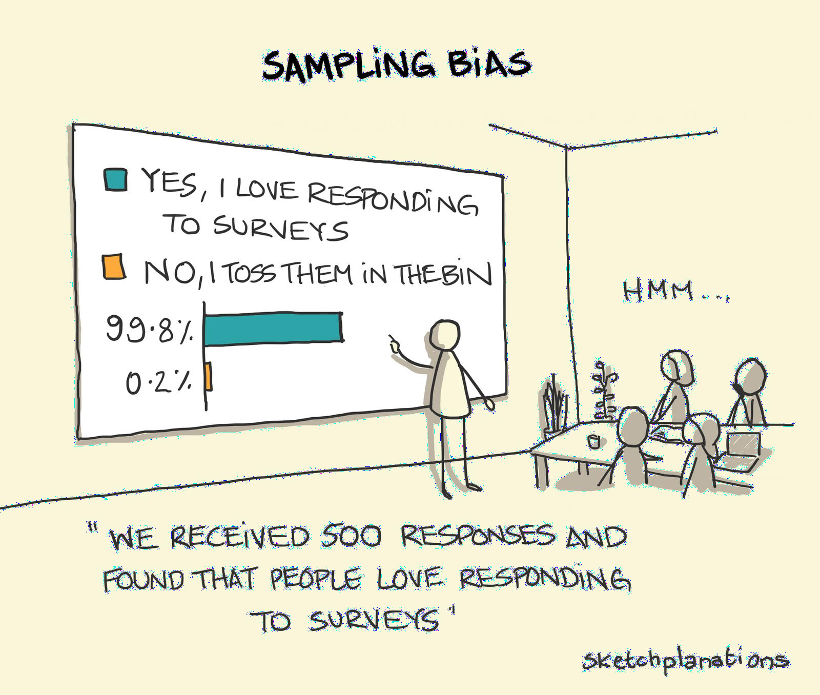

Slide 7
Bad Question | Good Question
Q: Do you use Foodpanda? [ o ] Yes [ o ] No | Q: Which food delivery app do you use? [ o ] Uber Eats [ o ] Pathao Food [ o ] Foodpanda [ o ] Others: (mention)
Q: Do you find the search feature useful? [ o ] Yes [ o ] No | Q: Tick all the features you find most useful about your food app. [ o ] Search [ o ] Online Payment [ o ] Schedule [ o ] Others: (mention)
Q: Do you think we should implement this feature? [ o ] Yes [ o ] No | Q: Tick the one new feature you would love to see in our app. [ o ] Search [ o ] Online Payment [ o ] Schedule [ o ] Others: (mention)

Slide 8
Clearly outline the purpose of the survey. In this sense, you should have a well-defined idea of what you intend to achieve with your survey. Do you want to gather feedback for a product or find out what customers think about a business decision?
Make sure your questions are simple, straight to the point, and easy to
understand. Avoid making use of vague and ambiguous words.
Avoid double-barrelled questions: Ensure that each question requests one specific information from respondents. In other words, do not use one question to gather information for multiple contexts.
Avoid leading and loaded questions. These kinds of questions are infused with biases that prevent survey respondents from providing objective responses. For instance, when collecting feedback from clients on a product or service you can include an assumption-based leading question like: "How much did you enjoy using our product?" This question presupposes that the client must have enjoyed using the product and only inquires to the degree of enjoyment.
https://www.formpl.us/blog/good-bad-survey

Slide 9
Result Table
Create a table having the questions displaying the proportion of each possible answers and the decisions based in the result.
For example:
Question | Decision
Q1: Tick the one new feature you would love to see in our app. [ 48% ] Search [ 22% ] Online Payment [ 10% ] Schedule [ 20% ] Others: Customize Menu (15%) Theming (5%) | We should implement search option and online payment system.
Provide a short description of your project at the beginning of the Google form, so that the participant get an idea about it.

Slide 10
List of selected features
Based on the survey result, update your feature list from benchmark analysis and write down your short listed features.

Slide 11

Mention these five things about SWOT Analysis
Strengths: What is your team really good at? What do you offer
people that others can’t or don’t? (Internal good)
Weaknesses: What are some things that your team is not very good at, that others do much better? (Internal bad)
Opportunities: What are some areas that your organization could thrive in that it isn’t currently taking advantage of? (External good)
Threats: What are some external factors—competitors, consumer demand, economic conditions—that could make it more difficult for your team to succeed? (External bad)
Strategy: Your conclusion based on the four points above (What are you going to do)
https://blog.capterra.com/s-w-o-t-analysis-examples-for-beginners/

Slide 12



Free or open source Project Management (PM) software
Strengths Free Community support makes open source more agile Basic versions are often easier for new users | Opportunities Try out PM software without a financial commitment Save company resources for the annual holiday party Stick it to the man by using open source
Weaknesses Limited features Limited customer support Infrequent updates | Threats Missing out on all the extra features of paid software Your open source PM software is abandoned by the developer Trying to get customer service on a free version in the middle of a hectic project
Strategy: Free project management software has its limitations, but can be a good fit for small teams or freelancers looking to try it out for the first time. But it is not a replacement for full featured project management software.

Slide 13

Ser | Criteria
1 | Survey Attendee Statistics
2 | Survey Result Table
3 | List of selected features
4 | SWOT & Strategy

Slide 14
Thank You

